Slide 1
Water Board Oversight
Sable Pipelines
CA-324 & CA-325
March 13, 2025

Slide 2

Water Boards’ Mission Statement​
2
Preserve, enhance, and restore the quality of California’s water resources and drinking water for the protection of the environment, public health, and all beneficial uses, and to ensure proper water resource allocation and efficient use, for the benefit of present and future generations.
Notes:
State Water Resources Control Board and the nine Regional Water Quality Control Boards are responsible for protecting California’s water quality under the federal Clean Water Act and the state’s Porter-Cologne Water Quality Control Act.

Slide 3
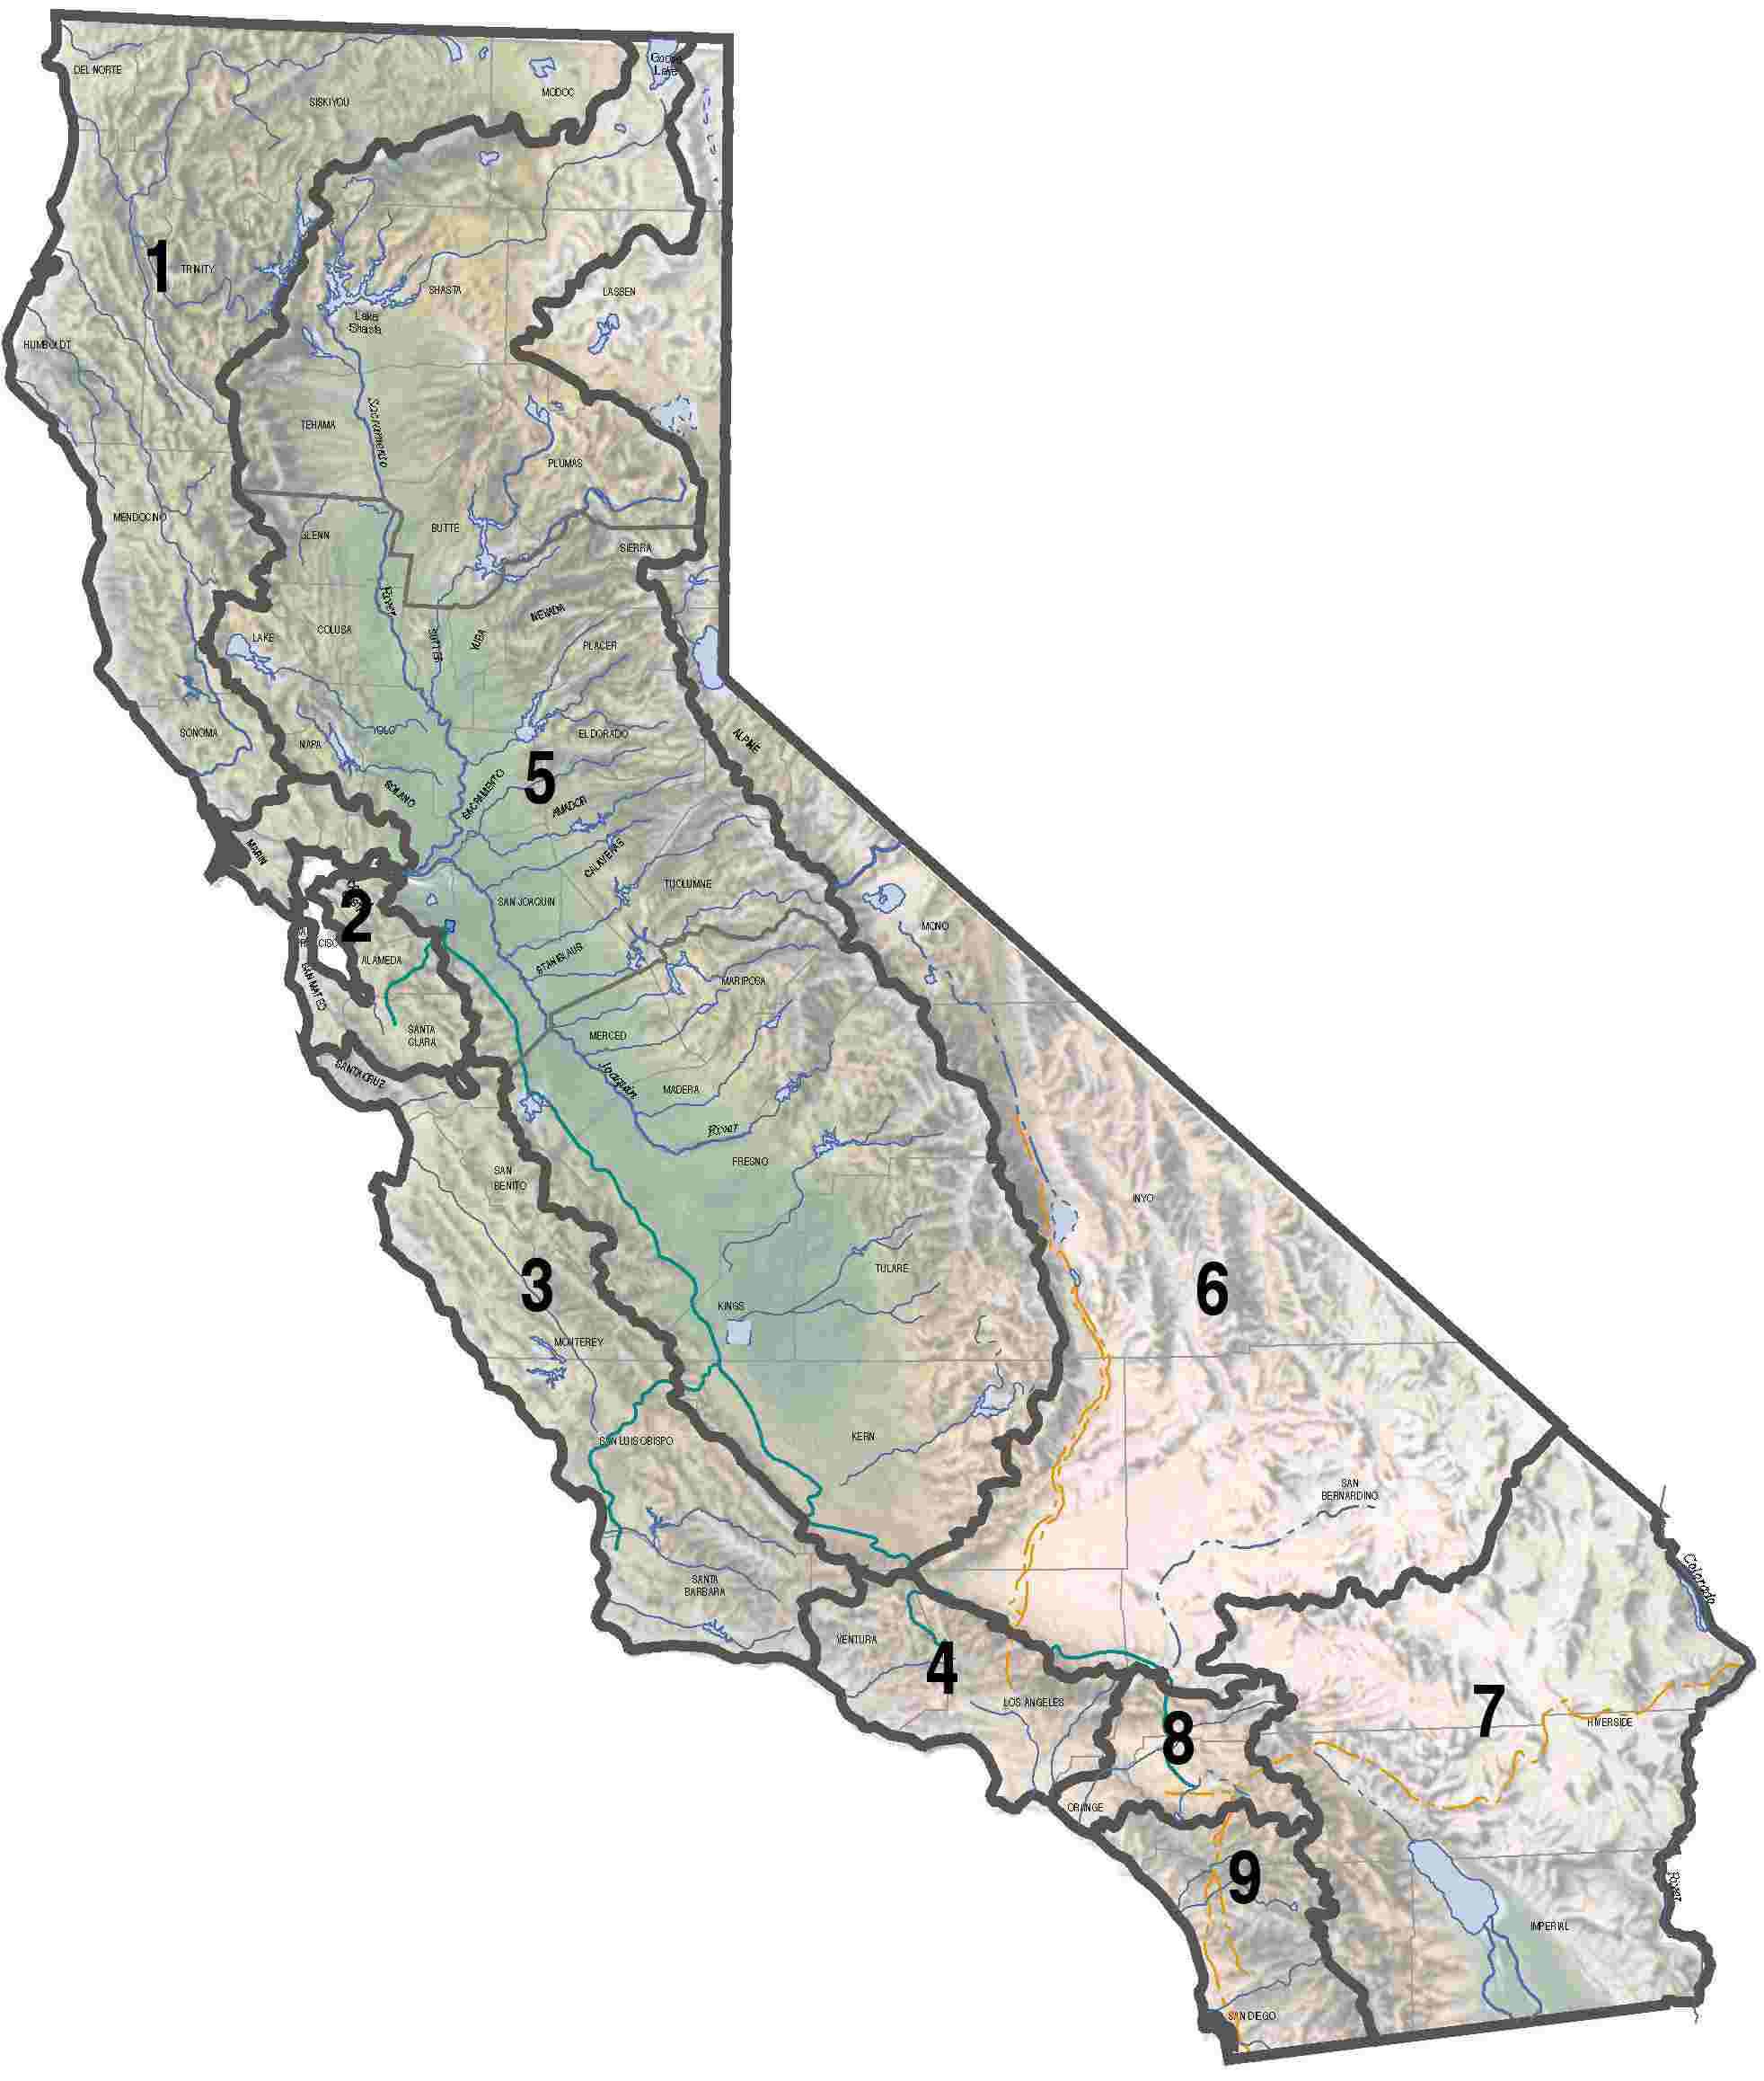
Water Boards’ Regulatory Role
Central Coast (3) and Central Valley (5) Regional Boards oversee protection of water quality in their jurisdictions, in which Pipelines CA-324 and CA-325 are located.
No known regulated activity within the Central Valley Regional Board’s jurisdiction.
Water Boards regulate the discharge of waste, such as sediment, into waters that could occur during pipeline repair or construction.

Slide 4
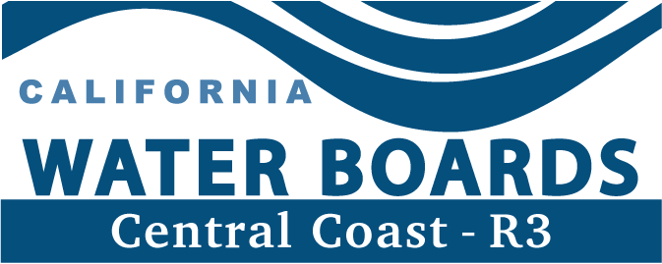
Recent Regulatory Actions
12/13/24
1/31/25
3/4/25
Central Coast Water Board issues notices for failure to obtain appropriate permits and directs Sable to obtain coverage
Sable submitted a permit application to perform work in a stream for one project area and a restoration plan
Sable submitted an application for coverage under the statewide permit for stormwater discharges
LEGEND
: Regional Water Board Actions
: Response from Sable
11/4/24
1/22/25
2/28/25
Central Coast Water Board staff inspects various project work locations
Central Coast Water Board issues investigative order requiring Sable to submit information
Central Coast Water Board Staff inspects new project work locations

