Slide 1
TOWN HALL:
State Oversight of Crude Oil Pipelines
March 13, 2025
CALIFORNIA STATE LANDS COMMISSION

Slide 2
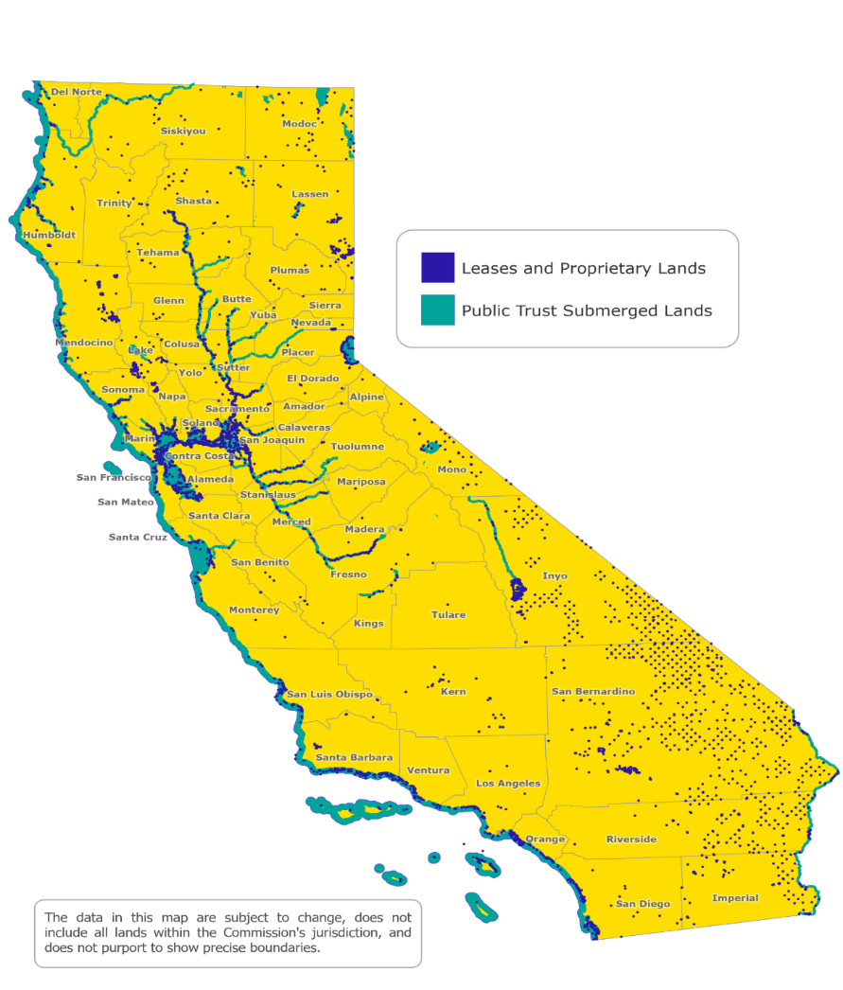
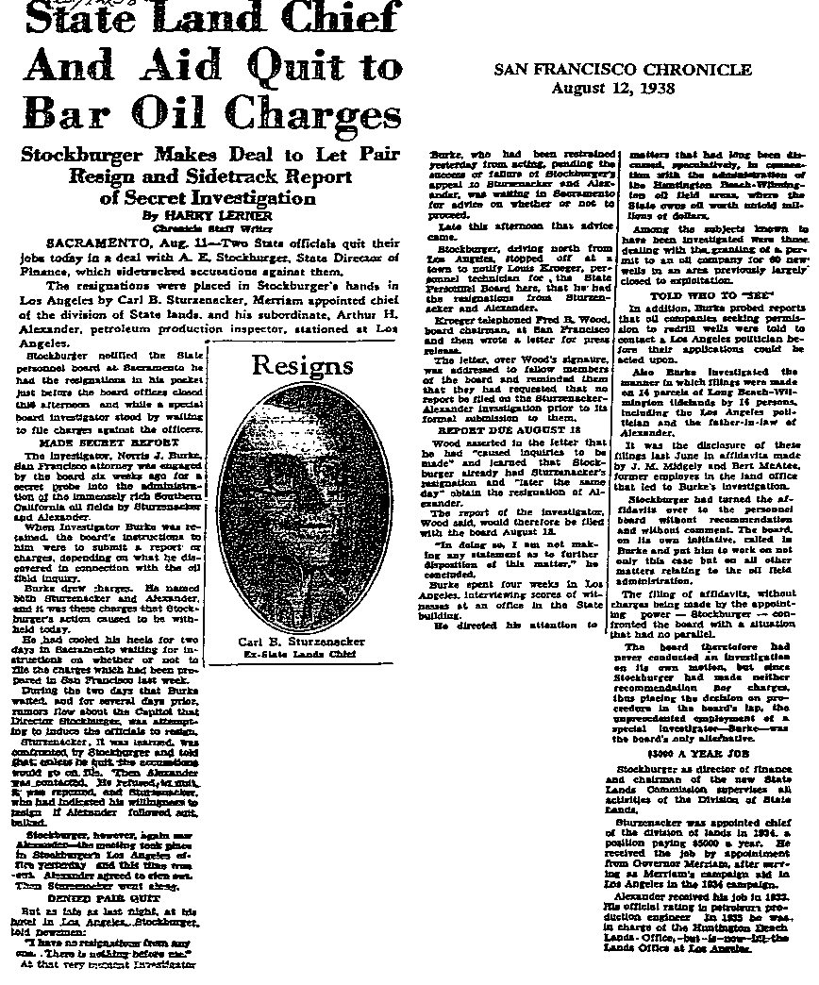
ABOUT THE STATE LANDS COMMISSION

Slide 3
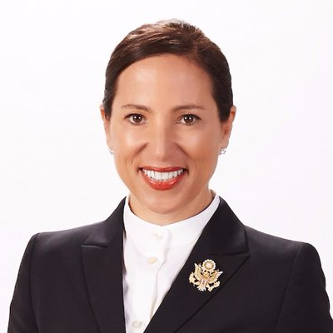
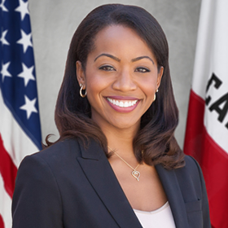
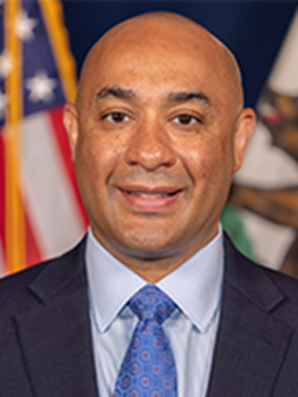
CALIFORINA STATE LANDS COMMISSIONERS
Lieutenant Governor
Eleni Kounalakis
State Controller
Malia Cohen
Director, Dept. of Finance
Joe Stephenshaw

Slide 4
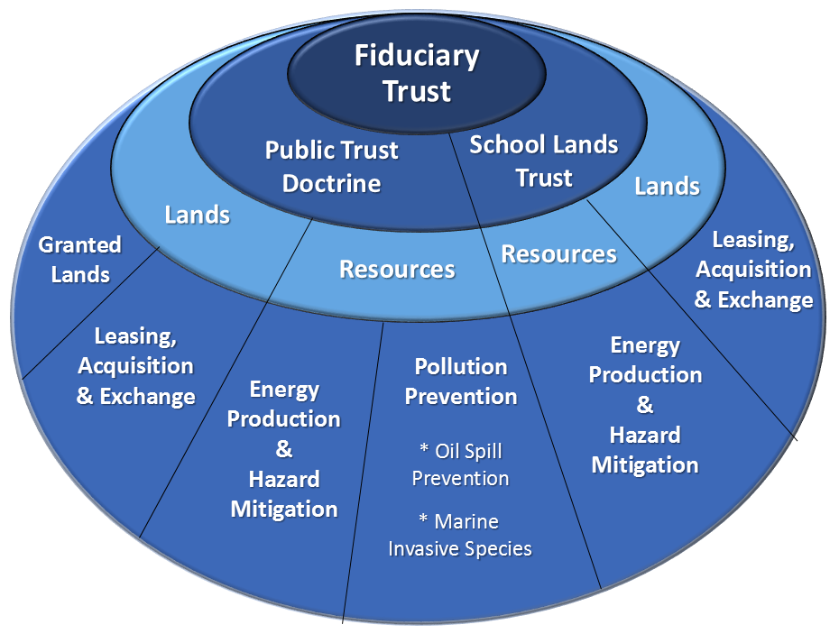
LAND AND RESOURCE TRUST MANAGER

Slide 5
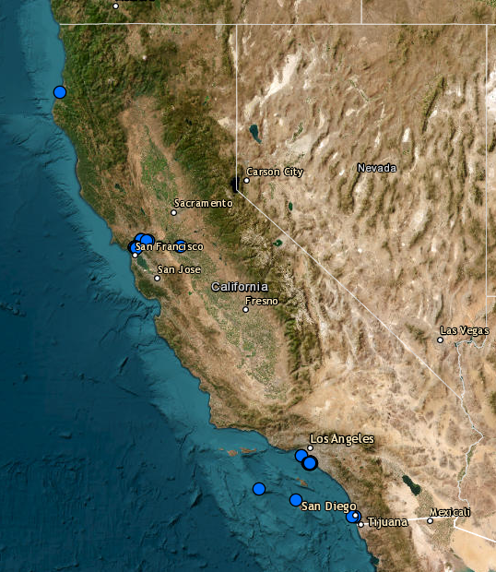
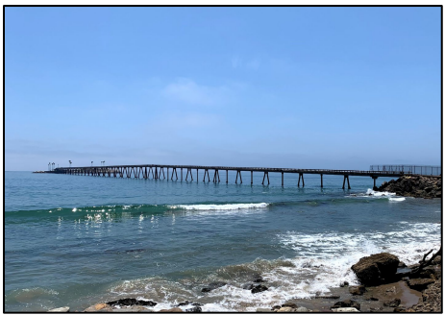
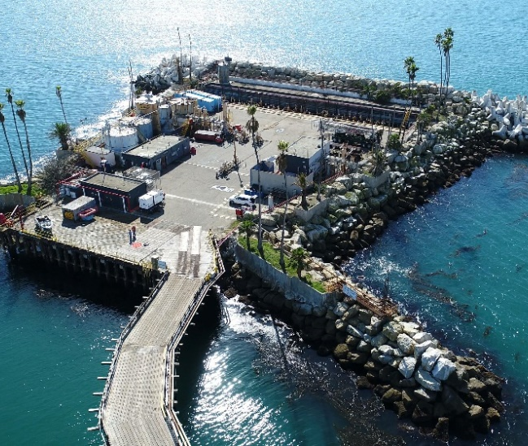
OIL AND GAS OPERATIONS

Slide 6
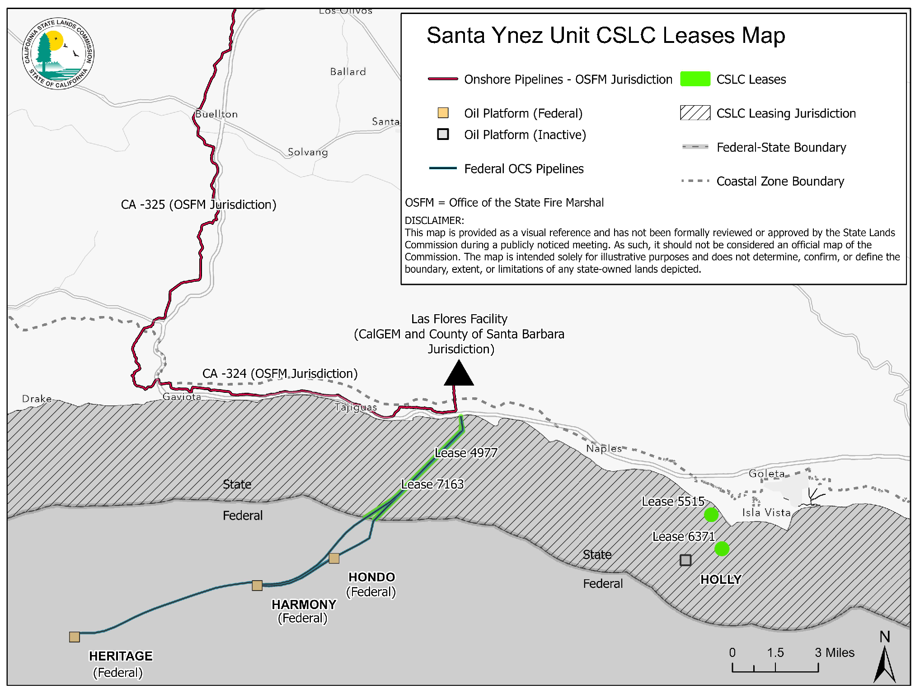
SANTA
YNEZ
UNIT

Slide 7
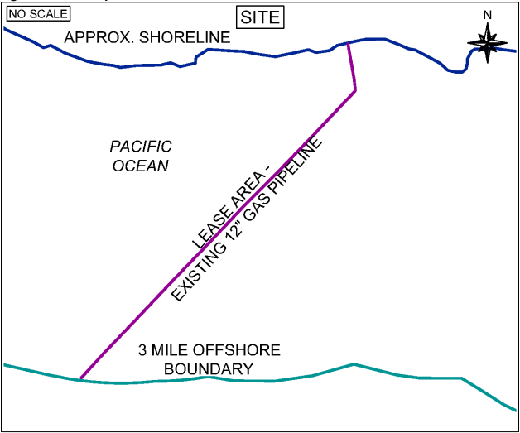
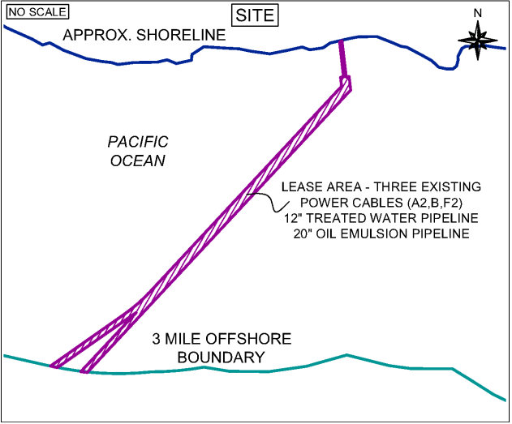
PIPELINE LEASES
Lease 4977
Lease 7163

Slide 8
LEASE CONDITIONS
Pre-start/Restart Inspections
Designation of Operator agreements
MUST comply with and is bound by ALL presently existing or subsequently enacted rules, regulations, statutes or ordinances of the Commission or any other regulatory agency with jurisdiction over the authorized improvements and proposed restart of the Santa Ynez Unit.

Slide 9



www.slc.ca.gov
THANK YOU & QUESTIONS
Grace Kato
Acting Executive Officer
Grace.Kato@slc.ca.gov
916.574.1227

