Slide 1
OSPR's Regulatory Role for Pipeline Operations
Mission: To provide the best achievable protection of California's natural resources by preventing, preparing for, and responding to spills of oil and restoring affected resources.
Contingency Plans
  Pipeline operators must have contingency plans for pipeline segments that threaten marine or inland waters of the state.
  Plans identify sufficient spill response resources and ability to respond to a calculated “reasonable worst-case spill”.
  CCR Title 14 Sections 815.01-818.03, 817.04
Certificates of Financial Responsibility
  OSPR issues Certificates of Financial Responsibility (COFRs) to pipeline operators after they have provided proof that they have the financial resources to cover the costs of response for their “reasonable worst-case spill”.
  An approved COFR is required prior to approval of a pipeline operator's contingency plan.
  CCR Title 14 Sections 791-798

Slide 2
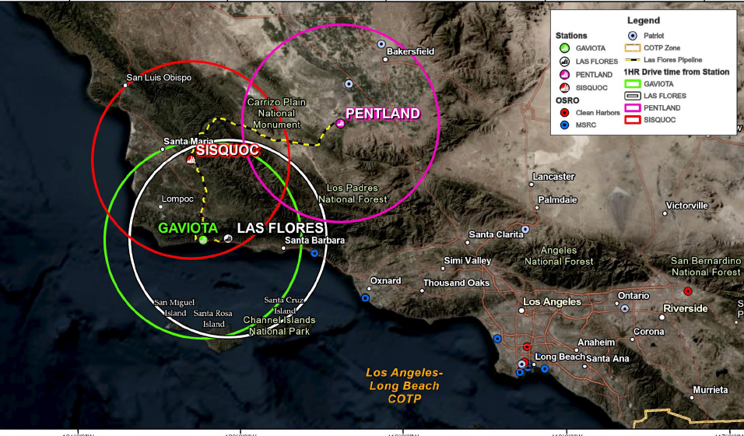
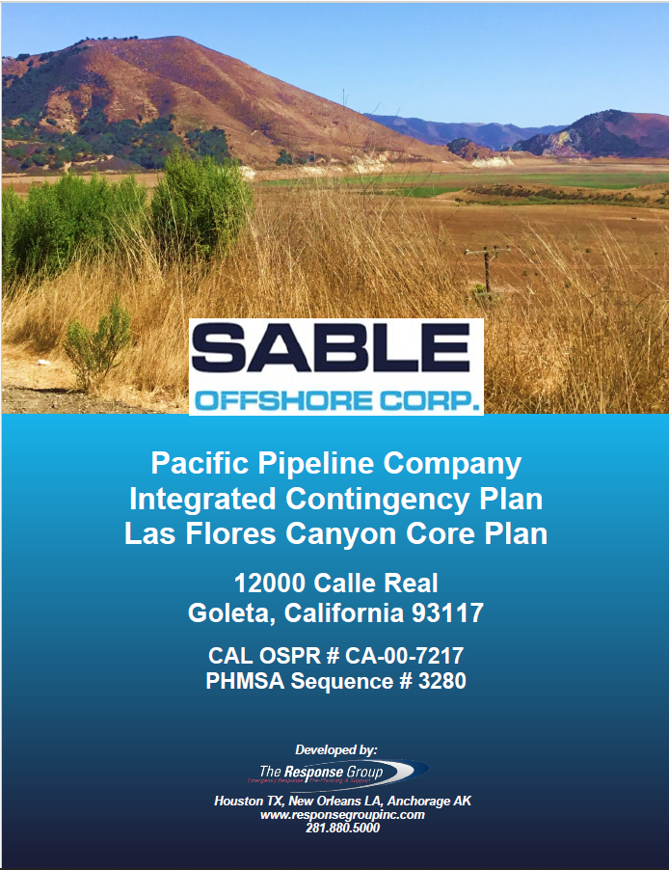
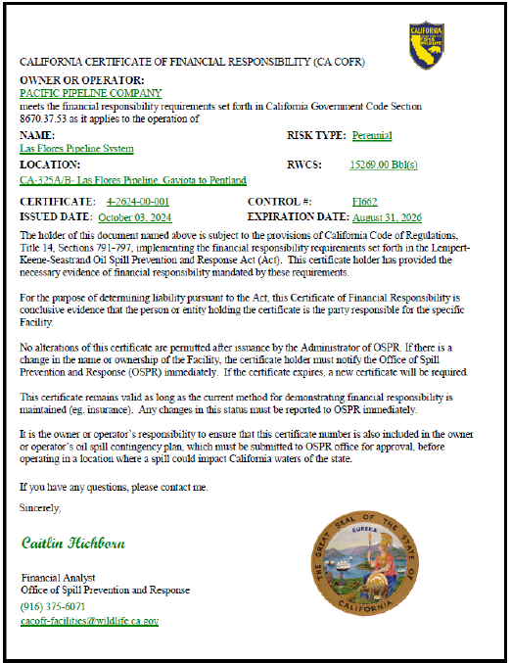
Onshore - Pacific Pipeline Company (CA-00-7217)
In this plan, OSPR regulates:
  CA-324 - Pipelines from the Las Flores Canyon Pump Station to the Gaviota Meter Station
  CA-325A/B - Pipelines from Gaviota Pump Station to the Pentland Meter Station.
OSPR has issued two Certificates of Financial Responsibility (COFR) for the $101M financial responsibility demonstrated by the operator, Pacific Pipeline Company.

Slide 3
Onshore - Pacific Pipeline Company (CA-00-7217)
April 2024
May 2024
June 2024
July 2024
Aug 2024
Sept 2024
Oct 2024
Nov 2024
Dec 2024
Jan 2025
Feb 2025
March 2025
Certificate of Financial Responsibility (COFR)
Application Submitted
COFR Approved
COFR Approved
Application Updated (RWCS)
April 2024
May 2024
June 2024
July 2024
Aug 2024
Sept 2024
Oct 2024
Nov 2024
Dec 2024
Jan 2025
Feb 2025
March 2025
Contingency Plan
Plan Submitted
1st Deficiency
2nd Deficiency
Plan Resubmitted
3rd Deficiency
Plan Resubmitted
Plan Resubmitted
Received Updated Plan

Slide 4
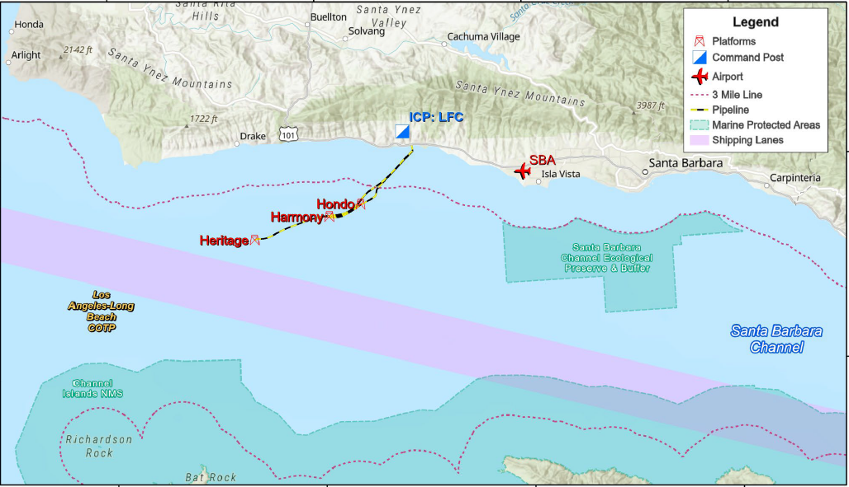
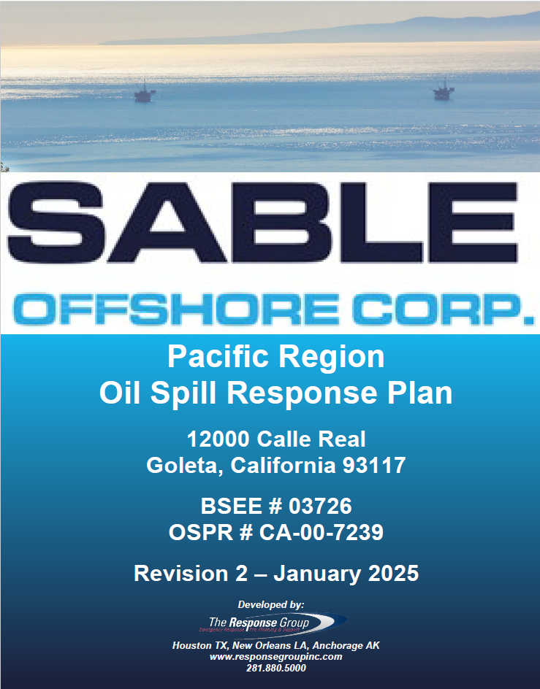
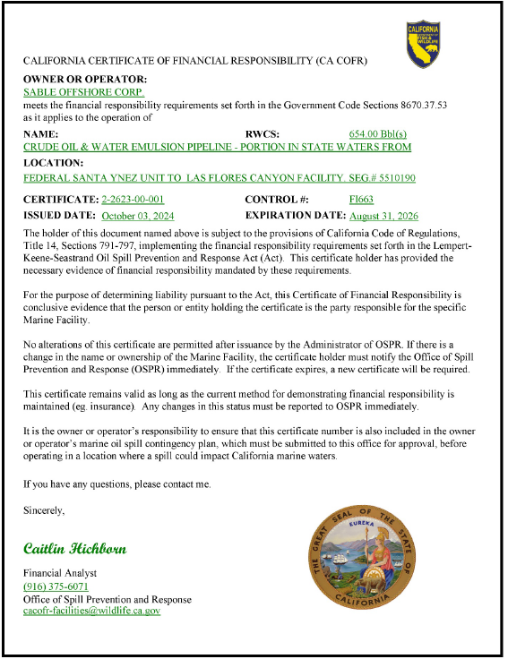
Offshore - Sable Offshore (CA-00-7239)
In this plan, OSPR only regulates the 20-inch diameter subsea pipeline that is in State Waters between Platform Harmony and the Las Flores Canyon Onshore Facility
OSPR has issued a Certificate of Financial Responsibility (COFR) for the $101M financial responsibility demonstrated by Sable Offshore.

Slide 5
Offshore - Sable Offshore (CA-00-7239)
April 2024
May 2024
June 2024
July 2024
Aug 2024
Sept 2024
Oct 2024
Nov 2024
Dec 2024
Jan 2025
Feb 2025
March 2025
Certificate of Financial Responsibility (COFR)
Application Submitted
COFR Approved
LFC COFR Withdrawn
COFR Approved
Application Updated (RWCS)
Application Updated (RWCS)
April 2024
May 2024
June 2024
July 2024
Aug 2024
Sept 2024
Oct 2024
Nov 2024
Dec 2024
Jan 2025
Feb 2025
March 2025
Contingency Plan
Plan Submitted
1st Deficiency
2nd Deficiency
Received Updated Plan
Plan Resubmitted
Plan Resubmitted

