Slide 1


California Department of Parks and Recreation
Armando Quintero
Director of CA Department of Parks and Recreation
Notes:
Good evening, I am Armando Quintero, the Director of the Department of Parks and Recreation, also known as State Parks.

Slide 2
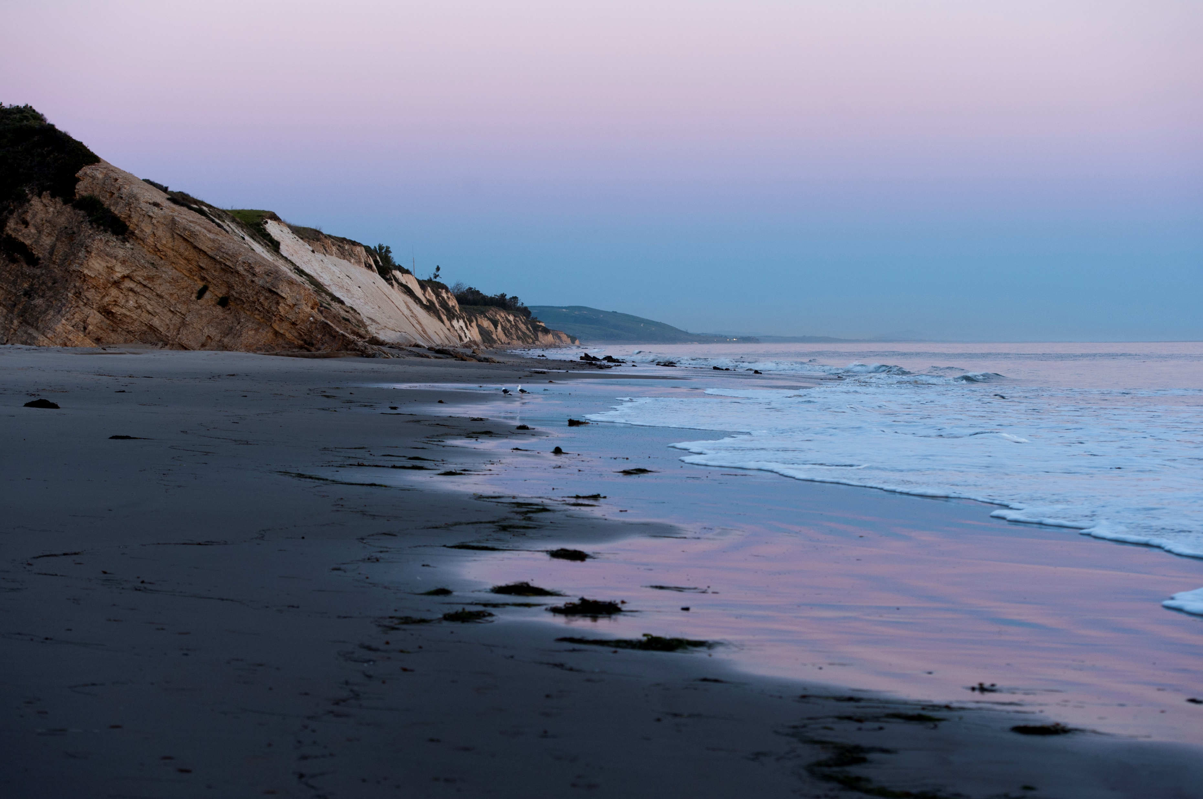
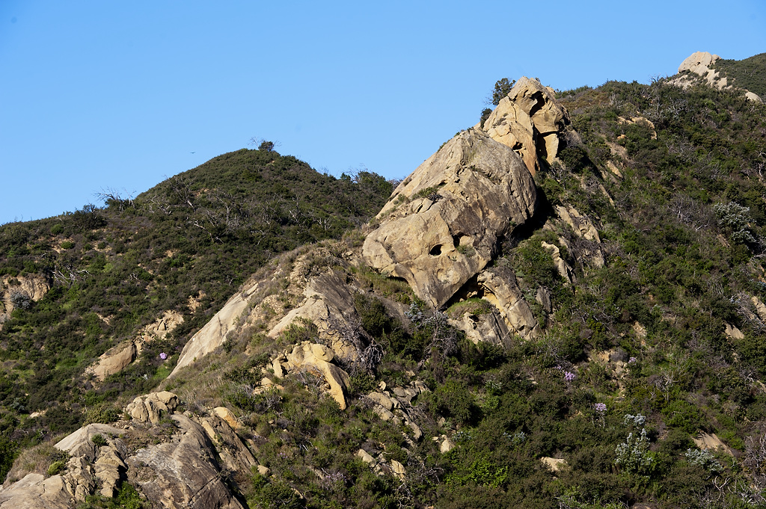
Background
CA State Parks has statutory authority to grant easements for limited purposes.
Additional approvals may be needed.
Easement from State Parks is required as 4 miles of an existing pipeline runs through Gaviota State Park. 30-year easement expired in 2016.
Notes:
California State Parks manages public land for public benefits in areas where onshore pipelines may cross. State Parks has statutory authority to grant easements for limited purposes, including for oil and gas lines, and depending on the terms, additional approvals by other State departments or agencies beyond State Parks may be needed.
Because the Sable pipeline runs through a four-mile section in Gaviota State Park, Sable requires an easement from State Parks. The previous 30-year easement expired in 2016. Since then, the department has issued individual permits for accessing and maintaining the pipeline. With Sable planning to restart this project, State Parks has requested a full project description to evaluate their request for an easement.

Slide 3
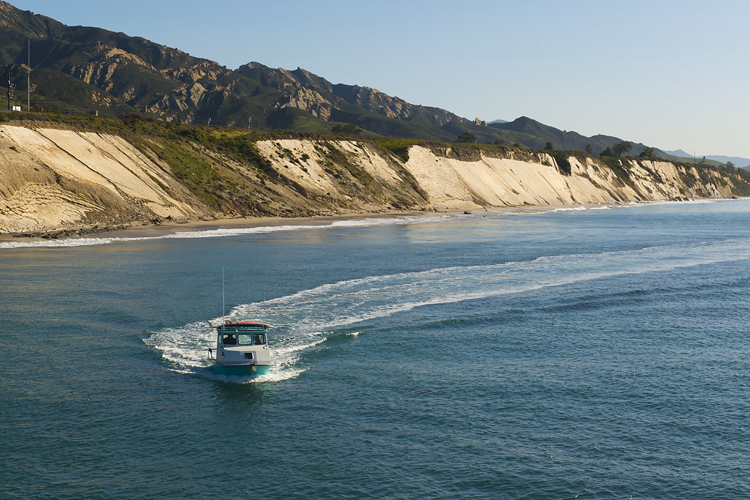
Easement Process
Application Evaluation by State Parks
Notes:
State Parks considers applications for a variety of private and public uses on State Parks’ properties. We consider the proposed use and duration in the context of a park’s General Plan, structures and improvements, cultural and natural resource protections, and programming. If the use complies with these aspects, State Parks may work with the applicant to approve their proposed use for an easement.
There are several steps in the easement application process. First, the State Parks evaluates the application as I previously described.

Slide 4
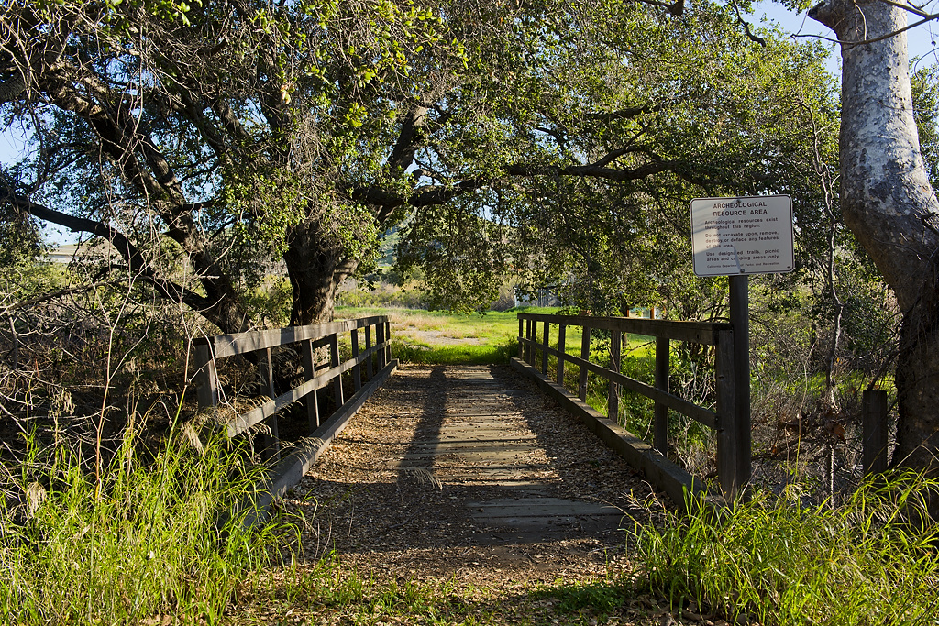
Easement Process cont.
Real Property Phase
Notes:
If the proposed use and duration do not present any conflicts, the application moves into the real property phase. State Parks works with the applicant to secure the required components, such as legal descriptions and an appraisal that meets state standards.

Slide 5
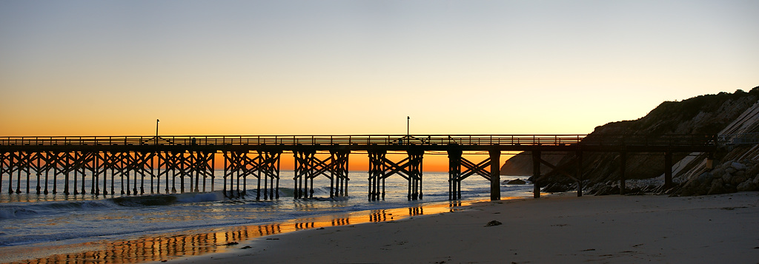
Easement Process
Depending on easement terms:
  Appraisal is reviewed and approved by State Parks
  Department of General Services (DGS) approve the easement
Notes:
Depending upon the easement terms, State Parks may review and approve the appraisal and other transaction elements, before drafting and finalizing an easement.
Depending upon the easement terms, the Department of General Services may play an authoritative role in the process, including approving the easement.

Slide 6
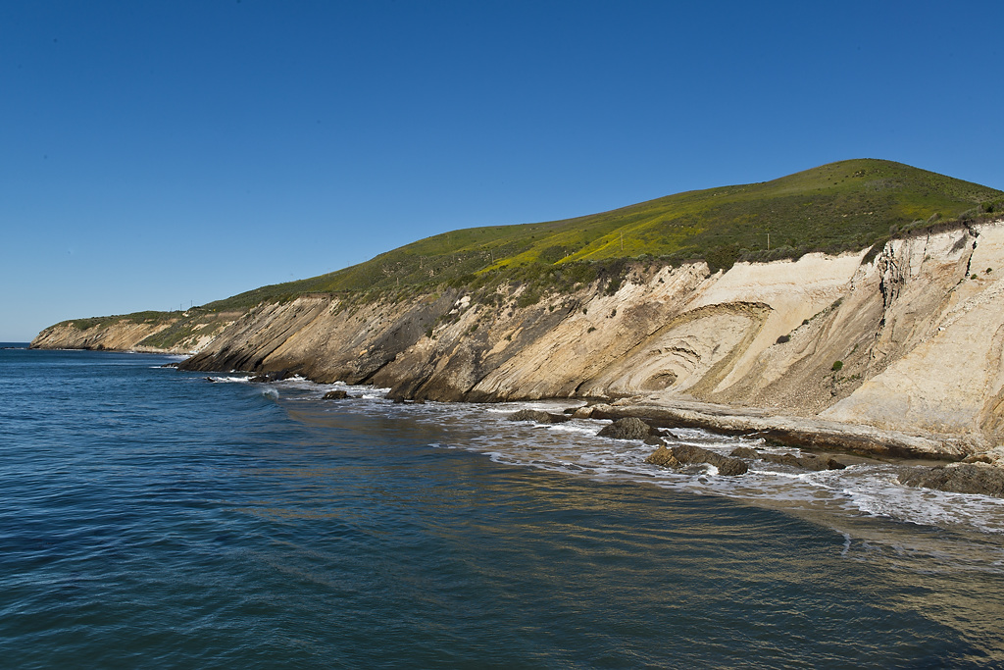
Easement Process Cont.
Applicants are responsible for state’s costs associated with the easement (research, evaluation, appraisal, etc.).
Notes:
Applicants are responsible for the state’s costs associated with research, evaluation, appraisal, and preparation of the transaction as well as the fair market value of the easement.

Slide 7
Easement Process Cont.
Safety considerations as part of the evaluation. Specific pipeline safety requirements are under the State Fire Marshall’s jurisdiction.
If the project is subject to CEQA/NEPA, it would need to comply with those requirements which include public notices.
State Parks evaluates applications within the context of a park’s structures, general plan, programming, and cultural and natural resource protections.
Notes:
What is a typical timeline for securing an easement?
Timeframes are contingent upon the features and complexity of a proposed use, whether additional reviews beyond the Department are necessary, and the time needed to negotiate the terms of the easement.
Does State Parks take safety considerations into account?
Yes, we consider this as part of the evaluation of the proposed use but the specific pipeline safety requirements are under the jurisdiction of the State Fire Marshal. There may be other laws and requirements that will also address safety or protection measures outside the scope of pipeline safety. If those exist, we will incorporate these and other measures determined necessary into the easement and related documents.
Why would State Parks consider allowing a pipeline within a State Park that, if it ruptures, would be very damaging to natural resources and visitor use?
4 miles of the Sable pipeline is within the jurisdiction of State Parks. State Parks evaluates applications within the context of a park’s structures, general plan, programming, and cultural and natural resource protections – and we incorporate the requirements imposed by state law and regulation as directed by the State Fire Marshal and other regulatory agencies for uses within State Parks.

Slide 8

Thank you

